Slide 1

Bitcoin Price Prediction
Notes:
1. Table of contents
2. Introduction
3. Our company
4. Our team
5. Problem
6. Them vs. us
7. Solution
8. SWOT analysis
9. Product overview
10. Our plans
11. Product demo
12. Traction
13. Case study
14. Reviews
15. Awards
16. Market size
17. Target
18. Competitors
19. Business model
20. Timing
21. Predicted growth
22. Investment

Slide 2
Our Team (Group 4)
Chheang Udomveasna
Heang Piseth
Seing Ratana
Heang Denis
Yong Lyhor

Slide 3
Table of Contents
1. Introduction
1.1 Data Description
2. Exploratory Data Analysis
2.1 Data Cleaning
2.2 Statistical Analysis
2.3 Visualizing the Data
3. Machine Learning
3.1 Split, Train, Test and Build the Models
3.2 Model Testing and Evaluation
3.3 Prediction
4. Conclusion
Reference

Slide 4

Introduction
The price prediction of Bitcoin using machine learning is a growing area of interest in the field of financial technology. This application leverages the power of machine learning algorithms to analyze historical data and market trends, enabling predictions about future Bitcoin price movements. Here's a concise introduction:

Slide 5
Data Description
This dataset captures the daily USD valuation of Bitcoin over a transformative decade from 2014 to 2024. As the first cryptocurrency, Bitcoin has redefined the financial landscape, showcased dramatic price volatility and sparked global interest.
The dataset contains over 3,650 daily entries, recording key metrics such as opening, closing, highest, and lowest prices in USD. Additionally, it includes daily trading volumes and market capitalization, offering a comprehensive view of Bitcoin’s performance.
Beyond raw data, this dataset provides valuable context by highlighting significant events, including major regulatory developments, adoption milestones, and Bitcoin halving’s. These factors help explain the trends and shifts in Bitcoin’s market behavior over time.
Ideal for researchers, investors, and students, this dataset serves as a powerful tool for exploring Bitcoin’s price patterns, market dynamics, and its influence on modern finance.

Slide 6
2. Exploratory Data Analysis
2.1 Data Cleaning
Data cleaning is the process of identifying and correcting errors and missing values in a dataset to ensure it is accurate, complete and ready for analysis.
Click Here
2.2 Statistical Analysis
2.3 Visualizing the Data
Visualizing the data is the process of representing data graphically using charts, graphs and plots.
Statistical analysis involves applying statistical methods to summarize, explore and interpret data. It includes calculating measures like mean, median, variance, and correlation, performing hypothesis tests.

Slide 7
3.
Machine Learning
Click Here!

Slide 8
2.18T $
Big numbers may help you catch your audience’s attention

Slide 9
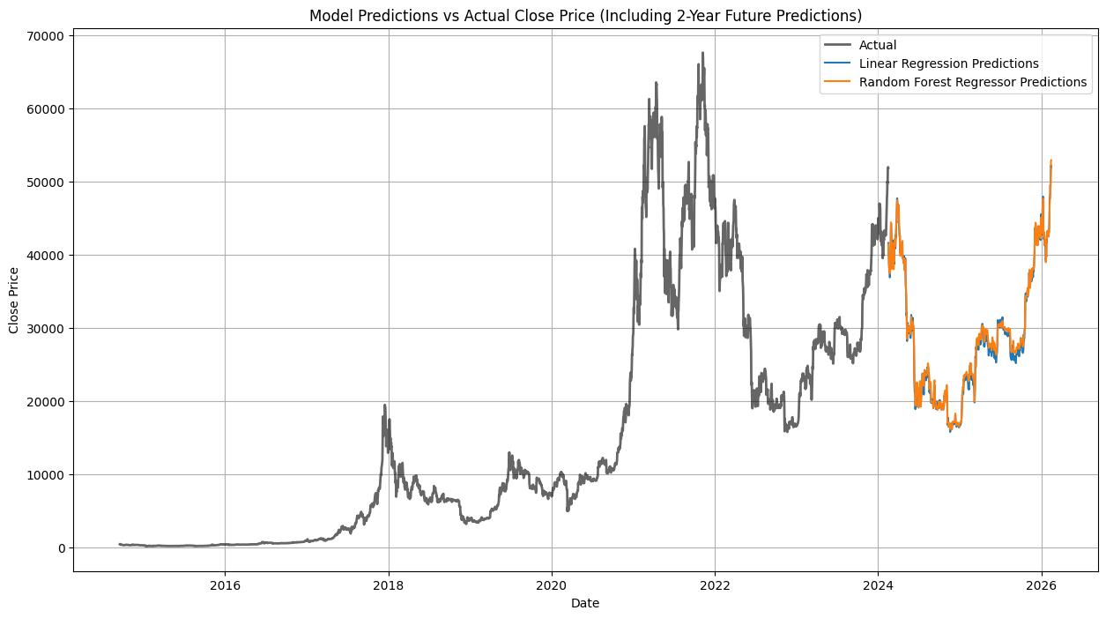
Predicted Growth
Trained Models Prediction
2021-2022
The Bitcoin price experienced dramatic volatility during this period. It reached an all-time high of nearly $70,000 in late 2021.
2023-2024
In this period, Bitcoin prices showed signs of recovery, climbing back steadily but with less extreme volatility compared to the previous years.

Slide 10
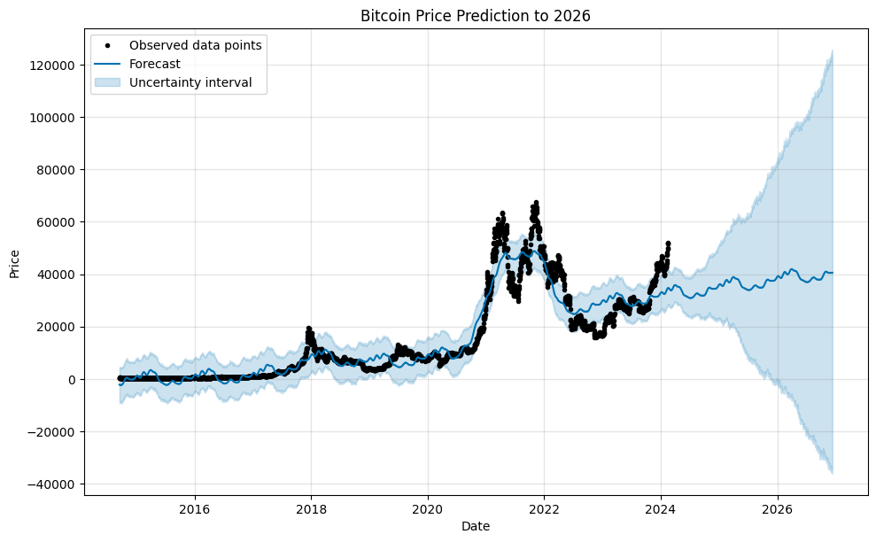
Forecasted Values
This Forecasted Value gave us the predicted price and also the lower and upper bound of the price.

Slide 11
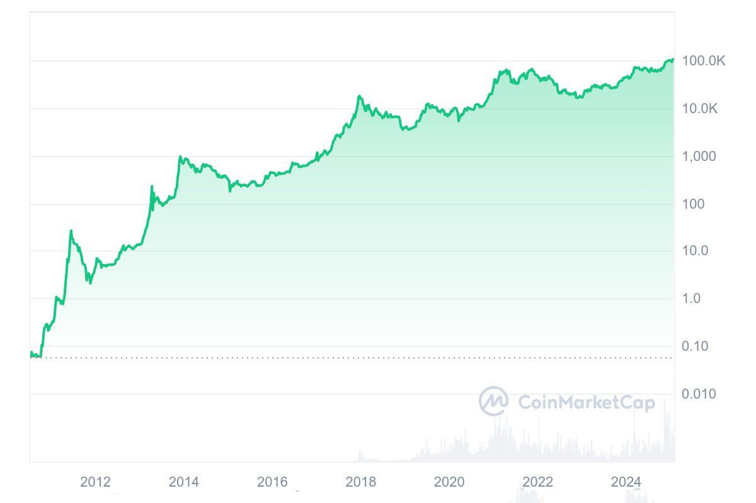
Compare with the real value of bitcoin nowadays, we can see there are huge differences in price. This suggest our models can’t accurately predict the price of Bitcoin in the future.

Slide 12
4. Conclusions
• Model Performance: Both Random Forest and Linear Regression achieved excellent results for regression and classification tasks.
• Bitcoin Price Forecasting: The predicted values provide a rough estimate of future prices, this indicate uncertainty in long-term predictions. There are a lot of reason behind this uncertainty such as: Politics, War and Major Events around the world.
• Recommendation: It seem very likely that the price of Bitcoin will continue to rise. Thus, for a long-term investment, we should buy and keep hold of it.

Slide 13
Referrence
Sources
Click Here!
Datasets
Kaggle

Slide 14
Thank you!
Do you have any questions?

